Slide 1
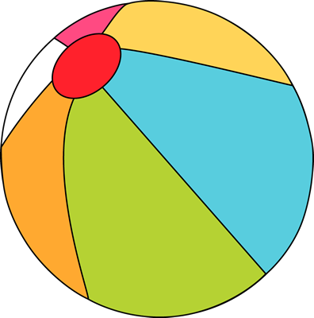
Sunday | Monday | Tuesday | Wednesday | Thursday | Friday | Saturday
 |  |  |  | 1 | 2 | 3
4 | 5 | 6 | 7 | 8 | 9 | 10
11 | 12 | 13 | 14 | 15 | 16 | 17
18 | 19 | 20 | 21 | 22 | 23 | 24
25 | 26 | 27 | 28 | 29 | 30 | 31
BridgePrep Academy of Tampa
Our Mission Statement
BridgePrep Academy believes every child learns best in a safe, nurturing and stimulating environment where high academic expectations, self-esteem, good character and an appreciation for the arts are promoted. BridgePrep Academy’s mission is to provide a challenging academic curriculum that will encompass an enriched Spanish language program, technology and experiences that will enable students to develop in all areas.
BridgePrep Academy’s goal is to educate well rounded individuals and enable students
to reach their maximum potential.
www.BridgePrepTampa.com
https://www.facebook.com/BridgeprepAcademyTampa/
Make sure to check the school website for all
upcoming events and updates
www.BridgePrepRiverview.com
School Hours
Kinder-5th grade
8:00-2:45pm
6th-8th grade
8:00-3:30pm
Middle School Lead Day
$1 School Spirit Day
PTC/SAC Mtg
8:15-9:15am
Middle School Lead Day
$1 School Spirit Day
Family Night
Middle School Lead Day
$1 School Spirit Day
BridgePrep Academy
of Tampa
2418 West Swann Avenue
Tampa, FL 33609
(813)258-5652

